Slide 1
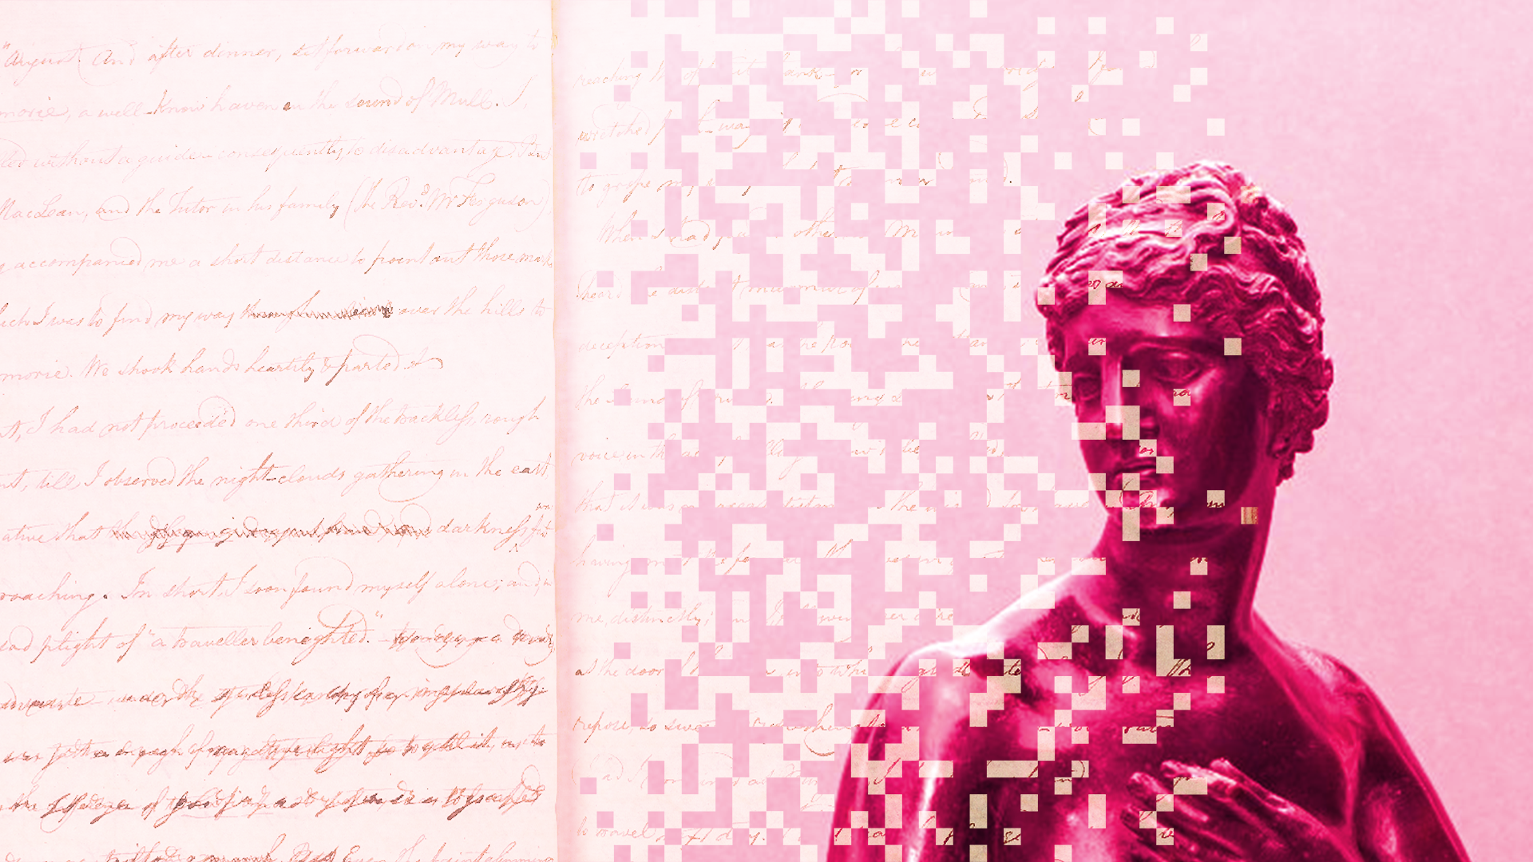



Data
Culture
society
@edCDCS
Notes:
MT

Slide 2


Working
with OCR
9 & 16 Oct 2025
@edCDCS
Notes:
MT

Slide 3


Overview
Day 1 (9 Oct.)
Introduction to OCR
Challenges of OCR in practice
Activity: Ready-made OCR tools
Day 2 (16 Oct.)
Review of programming basics
Introduction to OCR packages
Working with OCR in Python & R
www.cdcs.ed.ac.uk

Slide 4
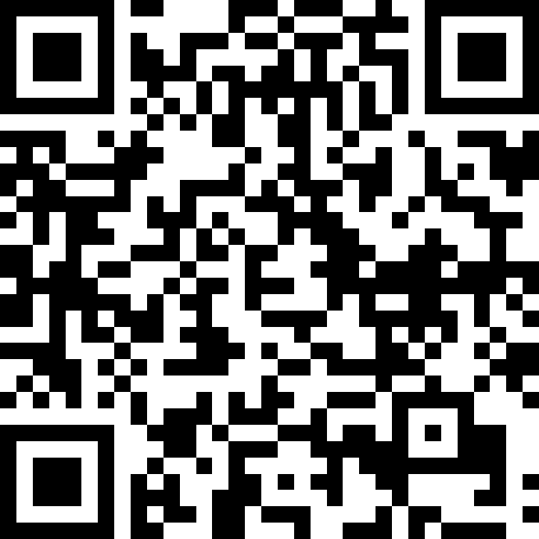
Course Material

Slide 5
Are you familiar with text extraction or OCR?
What OCR tools have you used, or do you plan to use in your work, and why?
Discussion
www.cdcs.ed.ac.uk

Slide 6
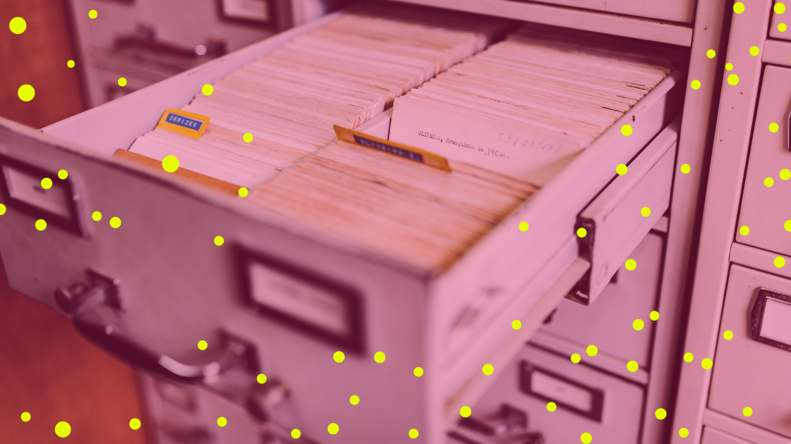
What Is OCR?
Optical Character Recognition
OCR is the technique to process images of text, such as written or printed documents, and produce machine-readable documents.
Machine-readable documents are encoded in formats that computers can process, allowing the text to be searched, edited and analysed.
www.cdcs.ed.ac.uk
Notes:
MT

Slide 7
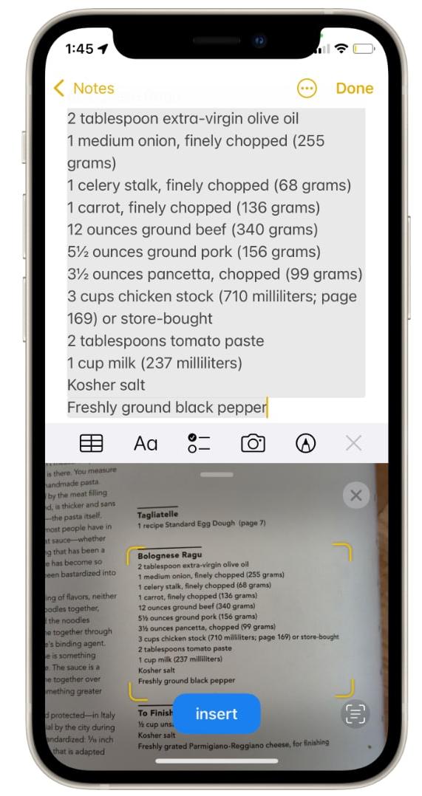
OCR In the Wild
Real-World Examples
Scanning your passport at the airport.
Generate machine-readable text for text-to-speech technology.
Making digitalised physical archives searchable.
Creating a dataset of for text mining or text analysis.
www.cdcs.ed.ac.uk
Notes:
https://www.cnbc.com/2021/09/29/ios-15-live-text-how-to-copy-and-paste-text-from-a-photo.html

Slide 8
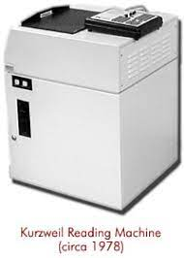
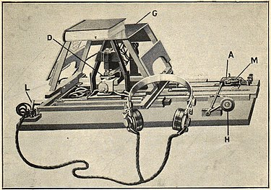
OCR Timeline: A Brief History
Early Foundations
1914: Emanuel Goldberg invents a machine that converts text into telegraph code; Edmund Fournier d’Albe invents the Optophone, which converts text to audio tones matched with letters
1931: Goldberg invents the “Statistical Machine,” which searches archives through optical code recognition
Mid-Century Machinery
1974: Ray Kurzweil develops the “Reading Machine,” an early form of OCR technology compatible with text-
to-speech software
1976: Kurzweil sells to Xerox
The Internet Era
1990s-00s: OCR goes mainstream; improved accuracy; mass digitization projects
00s-present: increased accessibility and accuracy
www.cdcs.ed.ac.uk
Notes:
MT

Slide 9
Select the images to be scanned
Scan the images with OCR software
Inspect and 'clean' the processed files
Save the results for further use
OCR workflow
www.cdcs.ed.ac.uk

Slide 10
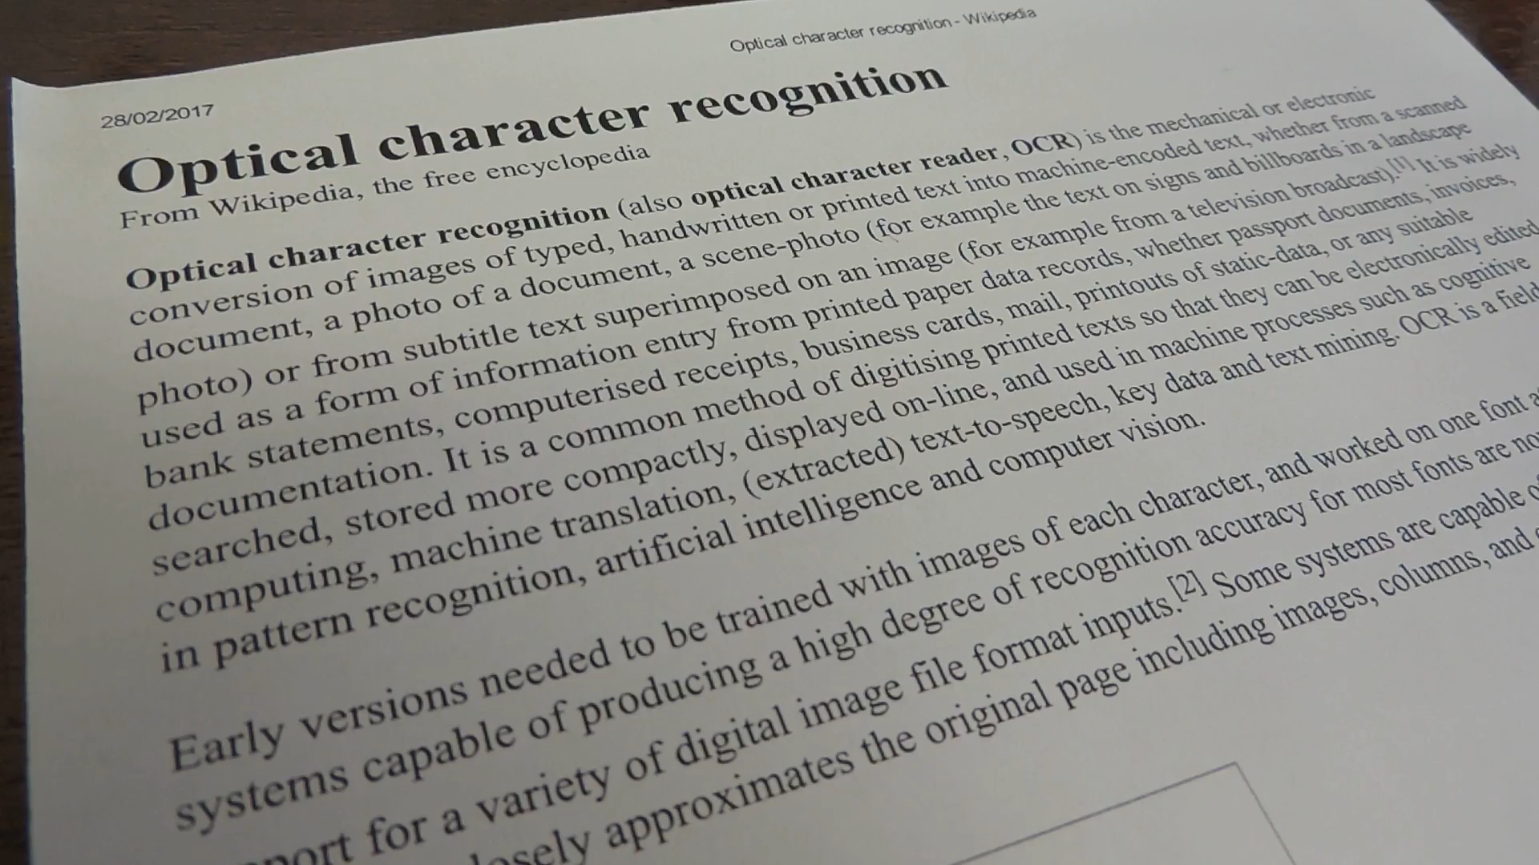
www.cdcs.ed.ac.uk

Slide 11

Activity:
OCR Workflow
Identify a dataset (images of text) that you might use in your research
Write the steps to obtained encoded text from your dataset. (e.g. software, OCR module)
Share your dataset, workflow, and plan with your small group.
Identify potential issue in each step. And discuss how you might address them.
www.cdcs.ed.ac.uk

Slide 12

Accuracy depends on dataset quality, visual complexity and software capability. Some common sources of error include:
Human errors and typos
Age and damage (stained or blurry)
Mixed text and images, or multiple languages
Cursive handwriting
Challenges of OCR
www.cdcs.ed.ac.uk
Notes:
MT

Slide 13
Possible solutions:
Select good quality dataset to begin with.
Pre-process your dataset to improve its quality
Correct errors in OCR-produced files, if they are predictable.
Improve OCR engine capability
Challenges of OCR
www.cdcs.ed.ac.uk
Notes:
MT

Slide 14
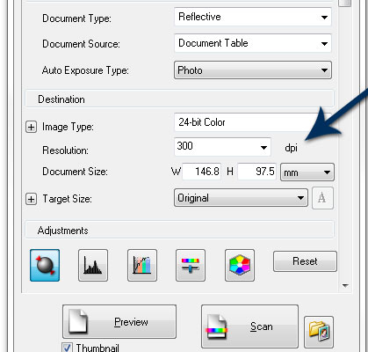
Data Selection
Image resolution
300 DPI is often used as a benchmark for good quality printing reproducibility for photographs, but this may vary
Ex. National archive
www.cdcs.ed.ac.uk
Notes:
MT

Slide 15
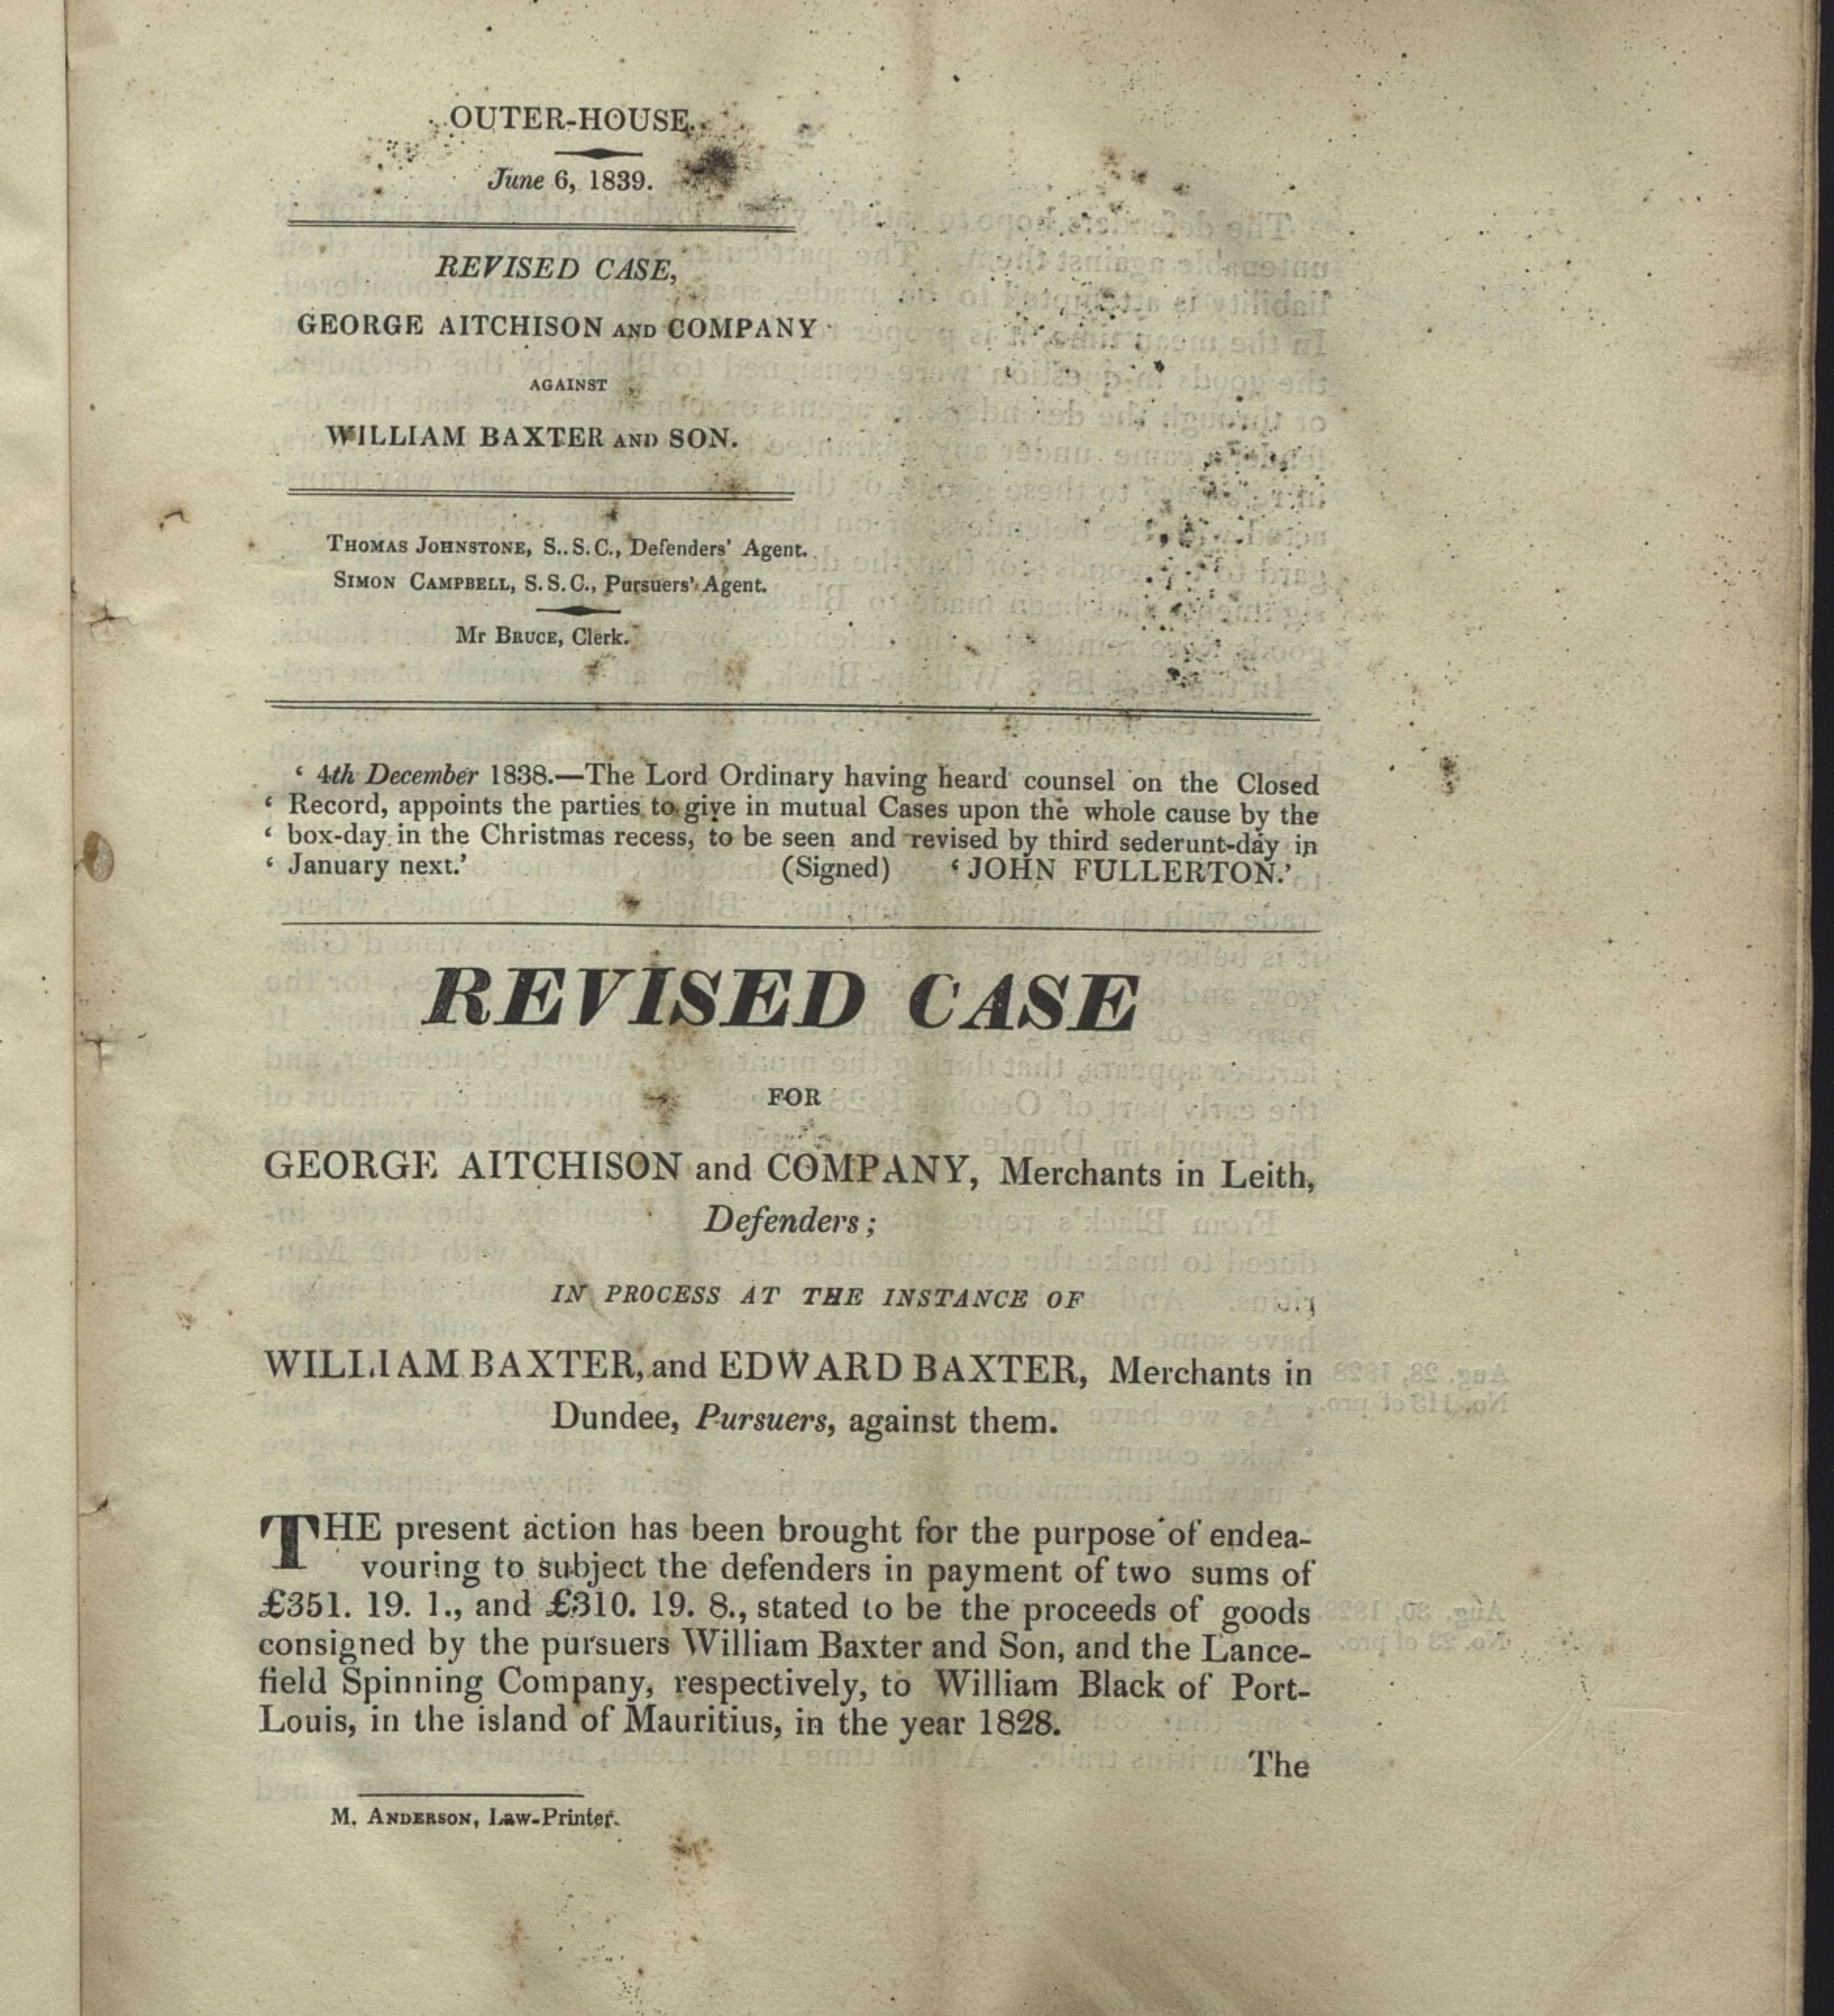
Data Selection
Manual inspection
www.cdcs.ed.ac.uk
Notes:
MT

Slide 16

Activity:
Inspect the Images
Identify issues you might encounter when processing the following images.
Are there any steps you could take to preprocessing the document that might improve the output accuracy?
www.cdcs.ed.ac.uk

Slide 17
Manually: Adjust the colour, contrast, or formats of the files.
OCR tools: Some OCR software have built-in correction functions such as patches.
Pre-processing
www.cdcs.ed.ac.uk
Notes:
MT

Slide 18
Pay attention to the limitations of the software
File Size
File Format
Text orientation
Languages
Scanning
www.cdcs.ed.ac.uk
Notes:
MT

Slide 19
Activity: Scanning
Identify a picture or scanned pdf
Scan the documents with OCR software
Compare the results and discuss what are the advantages and limitations of these options?
(if you can't find one, please try the pictures in the previous slides, or you can also try the Edinburgh archive database:
https://archives.collections.ed.ac.uk/)
https://tools.pdf24.org/en/ocr-pdf
https://www.onlineocr.net/
https://www.sodapdf.com/ocr-pdf/
https://www.sejda.com/ocr-pdf
https://ocr.space/
https://avepdf.com/pdf-ocr
www.cdcs.ed.ac.uk

Slide 20
Manually remove errors
Predictable errors can be fixed with codes , such as Regex.
Cleaning
www.cdcs.ed.ac.uk
Notes:
MT

Slide 21
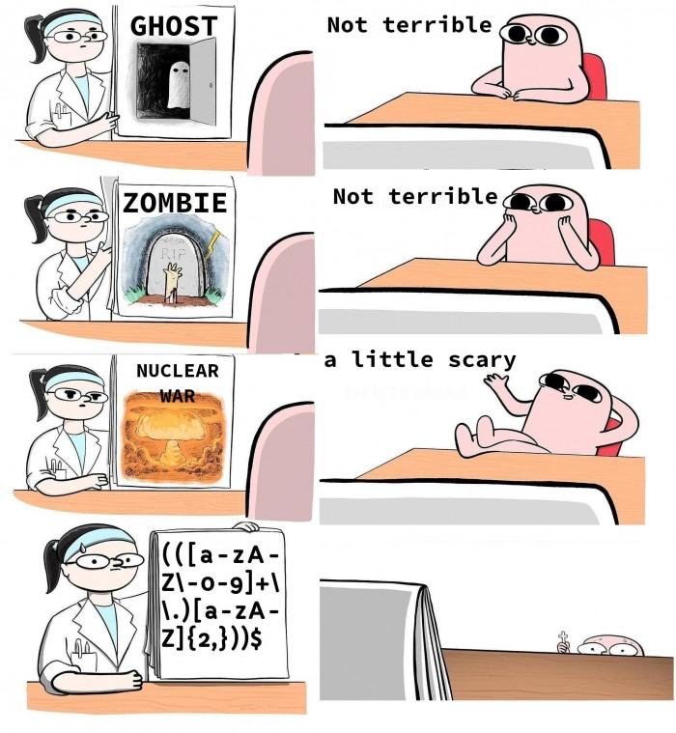
Regex
Concept used in many different programming environments for pattern matching.
Powerful tool to find, manage, and transform data and files.
Use a sequence of characters to define a search to match strings
Match on types of characters (e.g. ‘upper case letters’, ‘digits’, ‘spaces’, etc.).
Match patterns that repeat any number of times.
https://devhumor.com/media/the-nightmare
www.cdcs.ed.ac.uk
Notes:
MT

Slide 22
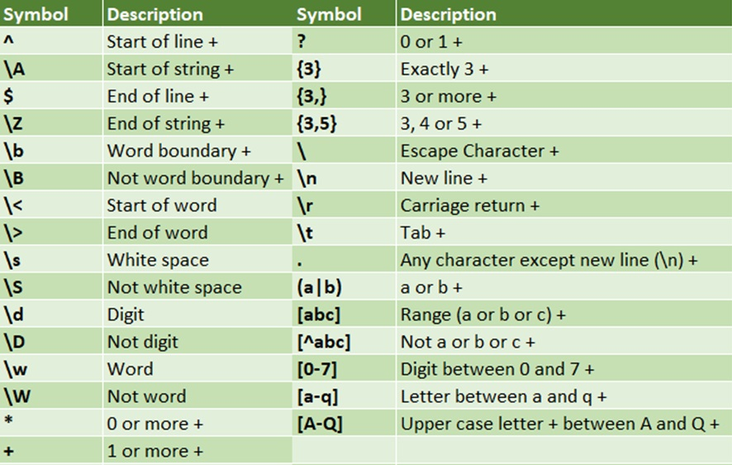
Regex
https://programminghistorian.org/en/lessons/cleaning-ocrd-text-with-regular-expressions
https://programminghistorian.org/en/lessons/understanding-regular-expressions
https://librarycarpentry.org/lc-data-intro/01-regular-expressions/
www.cdcs.ed.ac.uk
Notes:
MT

Slide 23
Printed Text Recognition
using Python pytesseract
Tesseract is an OCR engine developed for various operating systems
It has become open-source since 2005
It is of the most accurate open-source OCR engines available
Originally only support English, but more languages have been added
Can run from command line interface or embedded in main coding languages (R & Python)
www.cdcs.ed.ac.uk
Notes:
MT

Slide 24
Handwritten Text Recognition with Python trOCR
Select good quality dataset to begin with
Pre-process your dataset to improve its quality
Correct errors in OCR-produced files, if they are predictable.
Improve OCR engine capability
www.cdcs.ed.ac.uk
Notes:
MT

Slide 25

Digital Scholar Lab
www.cdcs.ed.ac.uk
Notes:
LO

